Slide 1
Chapter 1
The Role of the Algorithms in Computing
Sun-Yuan Hsieh
謝孫源 教授
成功大學資訊工程學系

Slide 2
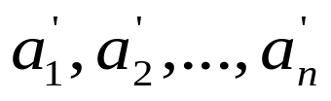
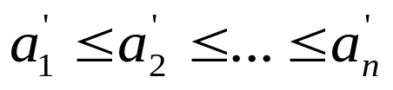


Algorithms
Algorithm: Any well-defined computation procedure that takes some value, or set of values, as input and produces some value, or set of values, as output.
Example: Sorting problem
  Input: A sequence of n numbers ⟨a₁, a₂,…, a_{n}⟩
  Output: A permutation ⟨ ⟩ of the input sequence such that .

Slide 3
An instance of a problem consists of the input needed to compute a solution to the problem.
An algorithm is said to be correct if for every input instance, it halts with the correct output.
A correct algorithm solves the given computational problem. An incorrect algorithm might not halt at all on some input instance, or it might halt with other than the desired answer.

Slide 4
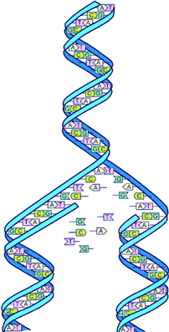

What kind of problem can be solved by algorithm?
The Human Genome Project
  Identifying all the 100,000 genes in human DNA
  Determining the sequence of 3 billion chemical base pairs that make up human DNA
  Storing information in human DNA databases
  Developing tools for human DNA data analysis

Slide 5


What kind of problem can be solved by algorithm?
The Internet Applications
  Internet enables people to quickly access and retrieve large amounts of information
  Finding good routes on which the data will travel (CH24)
  Using a search engine to quickly find pages on which particular information resides (CH11, 32)

Slide 6


What kind of problem can be solved by algorithm?
Electronic Commerce with Public-key Cryptography and Digital Signatures
  Electronic commerce enables goods and services to be negotiated and exchanged electronically
  Credit card numbers
  Passwords
  Bank statements private

Slide 7


What kind of problem can be solved by algorithm?
Manufacturing and Other Commercial Settings
  Allocating scarce resources in the most beneficial way
  How to assign crews to flights for an airline company?
  Where to place its wells for an oil company?
  Where to spend money buying advertising?
  Where to place more resources for an Internet service provider?

Slide 8

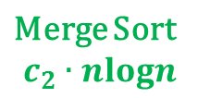
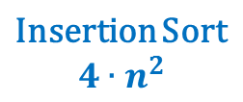

What kind of problem can be solved by algorithm?
Efficiency
  Algorithms devised to solve the same problem often differ dramatically in their efficiency
  These difference can be significant than differences due to hardware and software
  E.g., Sorting n items
Faster Computer
Slower Computer

Slide 9








What kind of problem can be solved by algorithm?
Efficiency
  These difference can be significant than differences due to hardware and software
Faster Computer
Slower Computer
Faster Computer
Slower Computer

